Slide 1

EVENT MANAGMENT

Slide 2
OUR TEAM
PRASANTH
SONALI
VISHAL
SURYA TEJA

Slide 3
For creating a event management Website we Need
Home page
Vendor page
Clients
Services
Gallery
Team
Contact
Blog

Slide 4
USED LANGUAGES :
HTML:
The Hyper Text Mark up Language, or HTML is the standard mark up language for documents designed to be displayed in a web browser. It can be assisted by technologies such as Cascading Style Sheets (CSS) and scripting languages such as JavaScript.
CSS:
CSS stands for Cascading Style Sheets
CSS describes how HTML elements are to be displayed on screen, paper, or in other media
CSS saves a lot of work. It can control the layout of multiple web pages all at once
External stylesheets are stored in CSS files

Slide 5
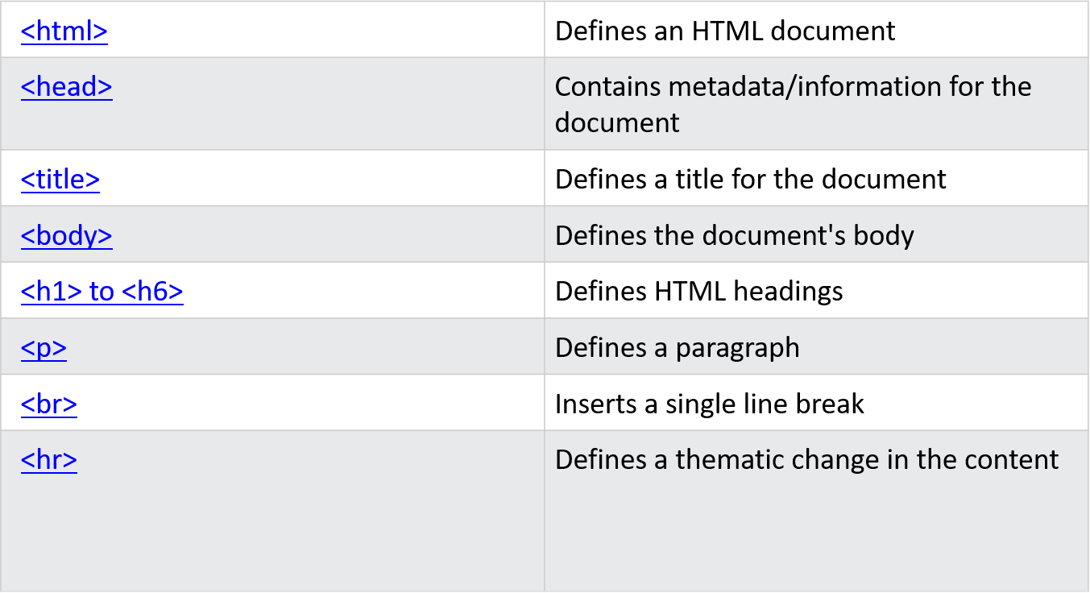
HTML TAGS USED:

Slide 6
CSS PROPERTIES USED:
1. CSS Variable :
CSS Variable properties are beneficial when we have to use something global available for my complete project, such as website colors.
2. Pseudo Elements
CSS Pseudo Elements is very useful when we insert any icon or anything before or after the HTML tag
3. Box Shadow
CSS Box Shadow is mainly used to achieve material or actual look box design.
4. CSS Flex
CSS Flex is very useful when we talk about alignments in design. We also said that advanced version of a float CSS property. By using flex, we can align our items vertically or horizontally and also in the group easily.

Slide 7
DESIGN:
1.Home page :
Divided the page into 3 parts header body , Main content and footer .
2. Next pages:
where we are displaying others sections based on the user requested like If they want to contact us or if they want see our latest blogs, clients ,services, vendors and also team members and gallery is added .

Slide 8
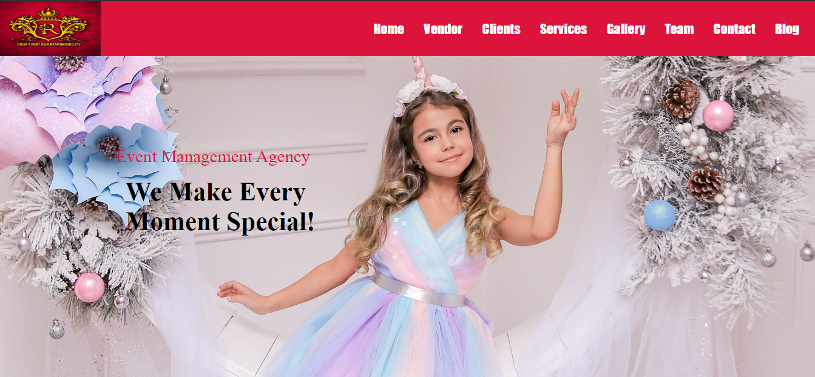
Outputs:
HOME

Slide 9
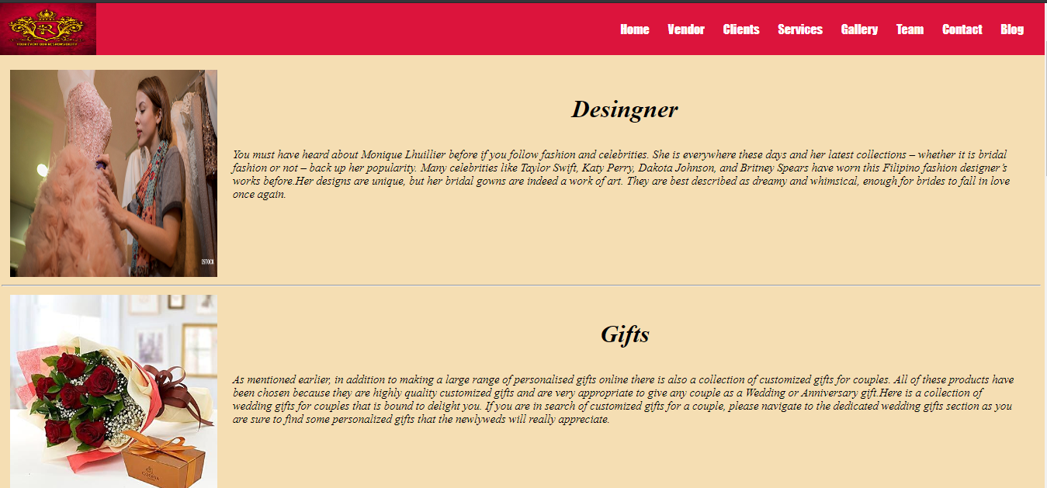
VENDOR:

Slide 10
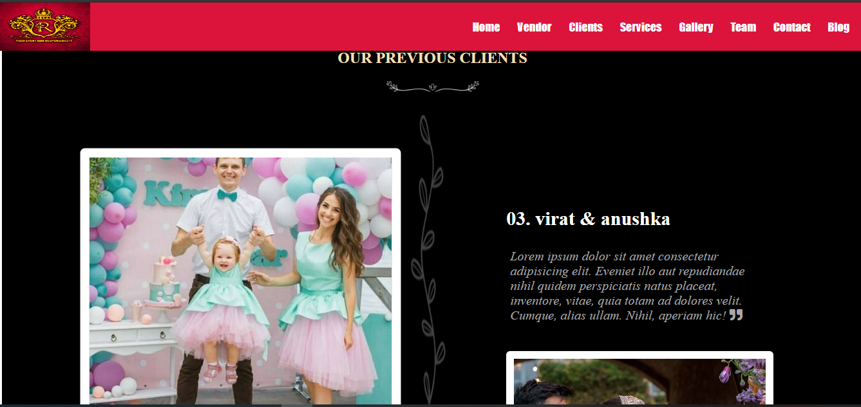
CLIENTS:

Slide 11
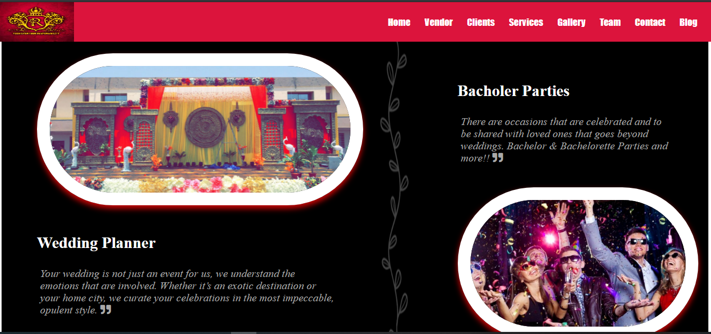
SERVICES:

Slide 12
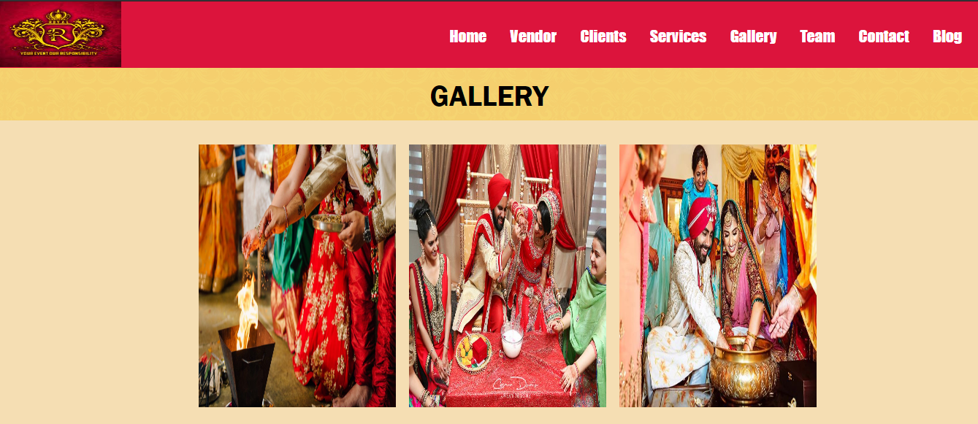
GALLERY:

Slide 13
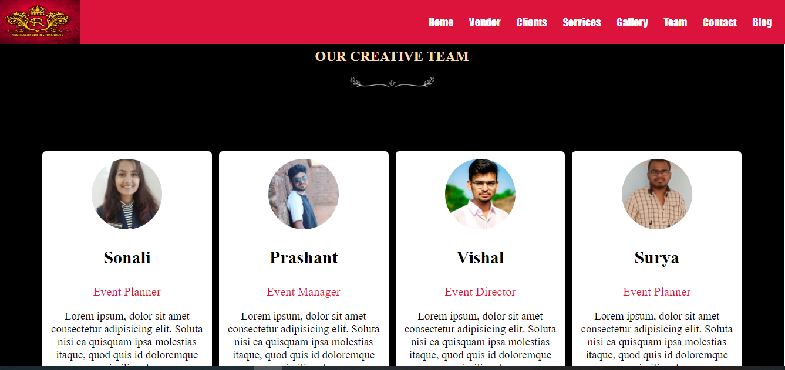
TEAM:

Slide 14
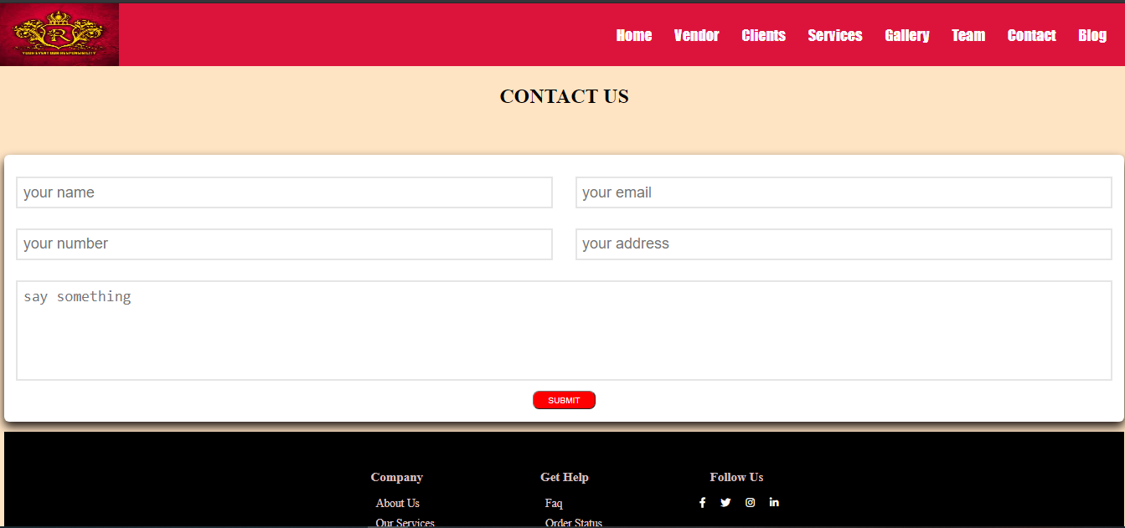
CONTACT:

Slide 15
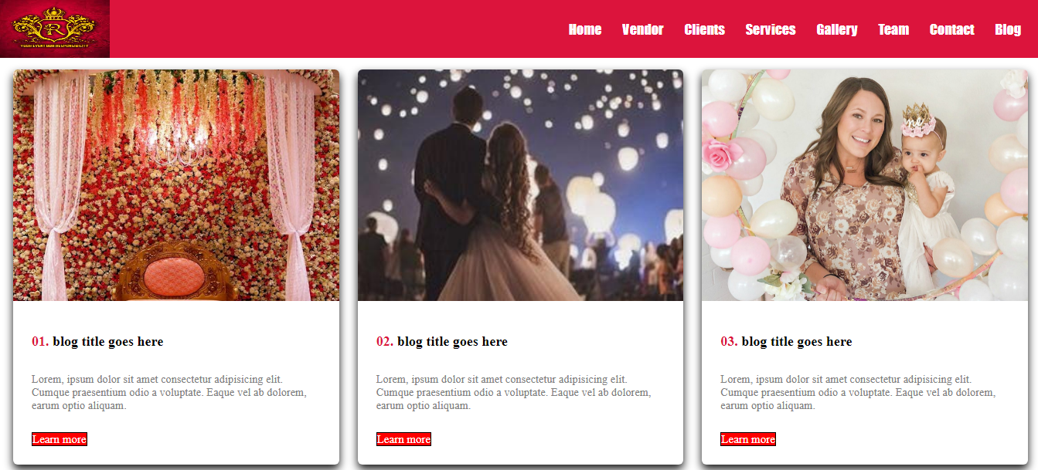
BLOGS:

Slide 16
Thank you…

